Slide 1



amazon
View in Power BI
Last data refresh:
3/8/2023 5:06:04 PM UTC
Downloaded at:
3/8/2023 5:16:27 PM UTC

Slide 2
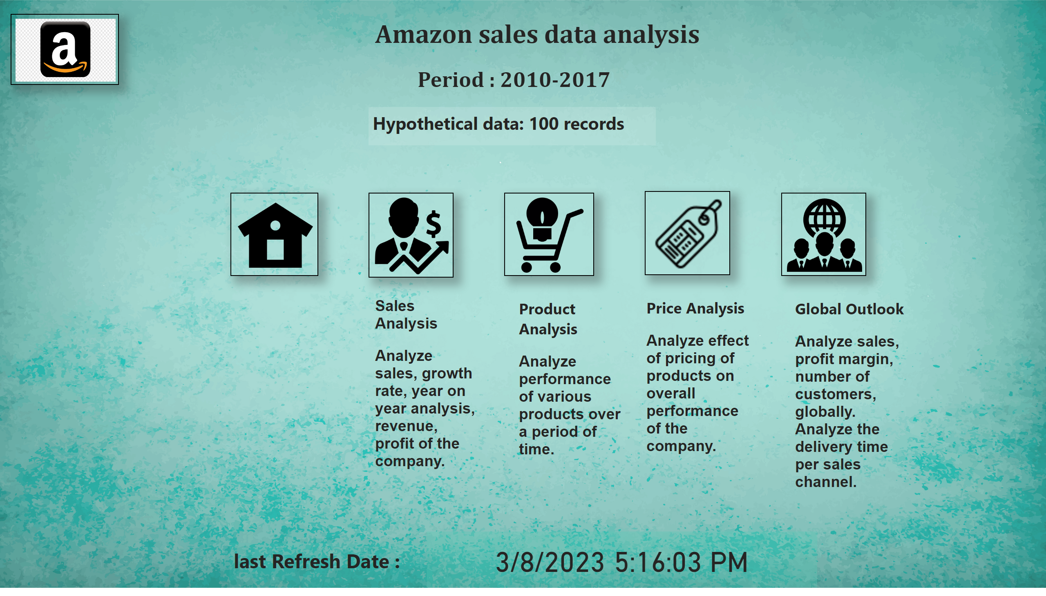
Home
Notes:
image
No alt text provided
image
No alt text provided
image
No alt text provided
image
No alt text provided
image
No alt text provided
textbox
No alt text provided
textbox
No alt text provided
textbox
No alt text provided
textbox
No alt text provided
textbox
No alt text provided
card
No alt text provided
textbox
No alt text provided
image
No alt text provided
textbox
No alt text provided
textbox
No alt text provided

Slide 3
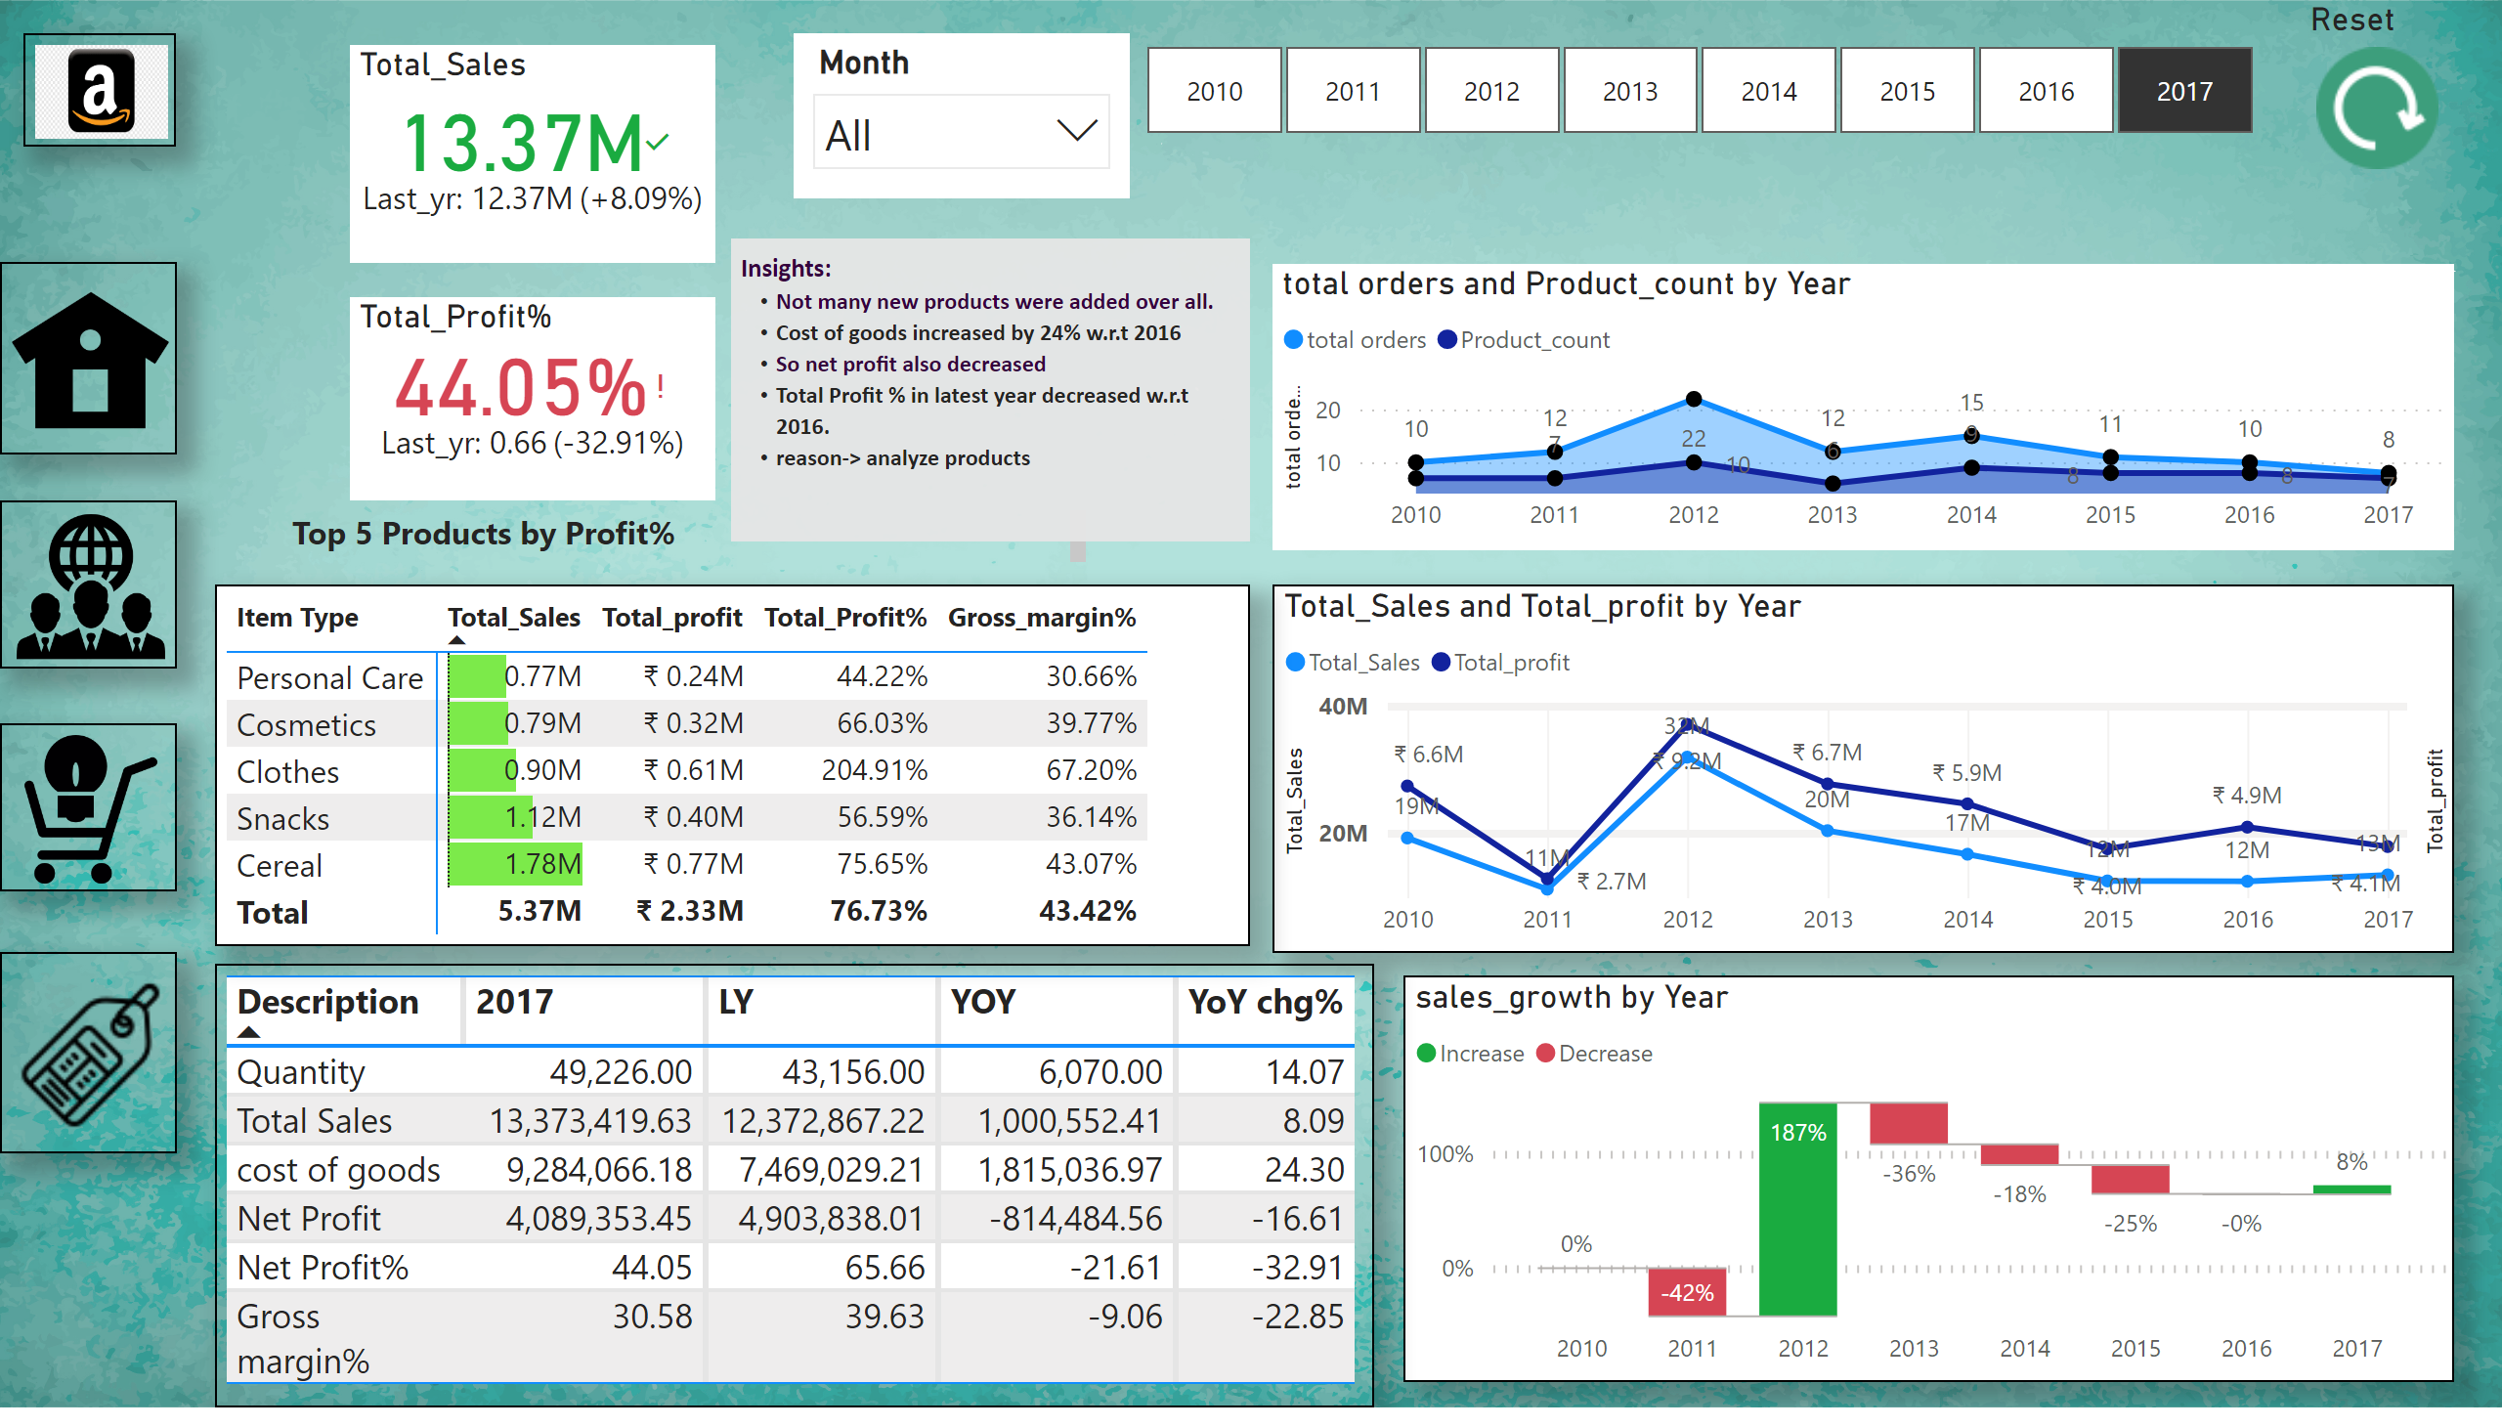
Sales analysis
Notes:
lineChart
No alt text provided
slicer
No alt text provided
waterfallChart
No alt text provided
pivotTable
No alt text provided
pivotTable
No alt text provided
textbox
No alt text provided
image
No alt text provided
image
No alt text provided
image
No alt text provided
Reset
No alt text provided
image
No alt text provided
Total_Sales
No alt text provided
Total_Profit%
No alt text provided
image
No alt text provided
slicer
No alt text provided
areaChart
No alt text provided
textbox
No alt text provided

Slide 4
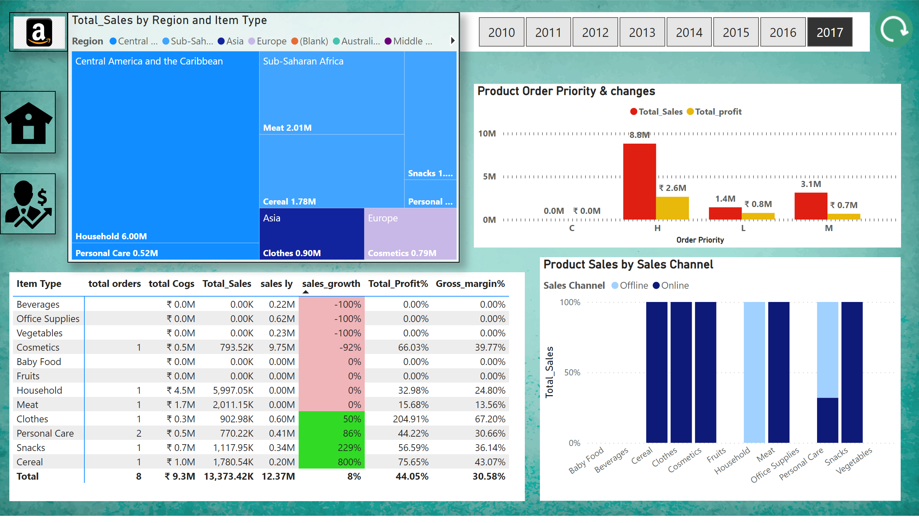
Product analysis
Notes:
slicer
No alt text provided
Product Order Priority & changes
No alt text provided
Product Sales by Sales Channel
No alt text provided
pivotTable
No alt text provided
image
No alt text provided
image
No alt text provided
image
No alt text provided
image
No alt text provided
treemap
No alt text provided

Slide 5
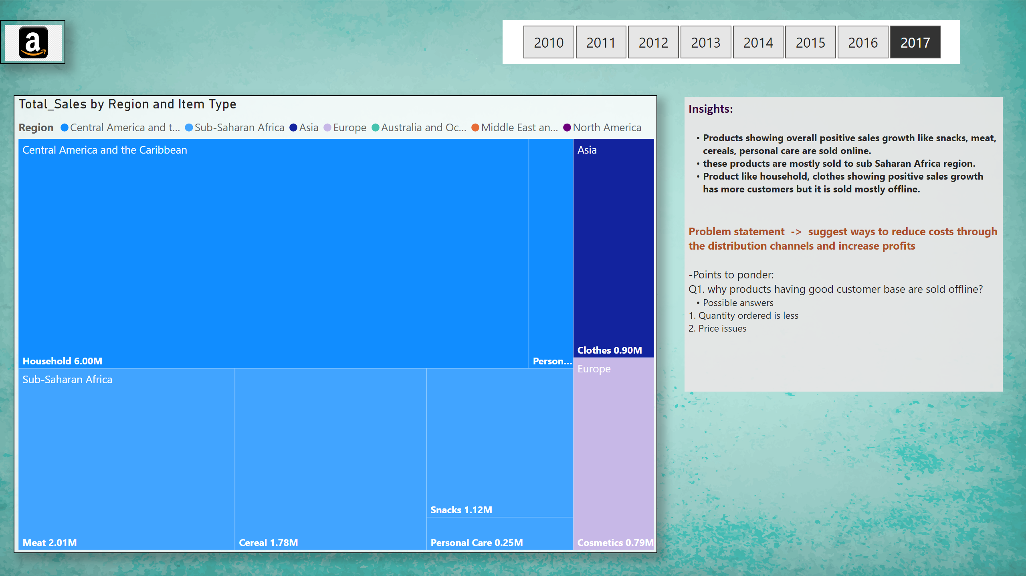
Product insights
Notes:
slicer
No alt text provided
image
No alt text provided
treemap
No alt text provided
textbox
No alt text provided

Slide 6
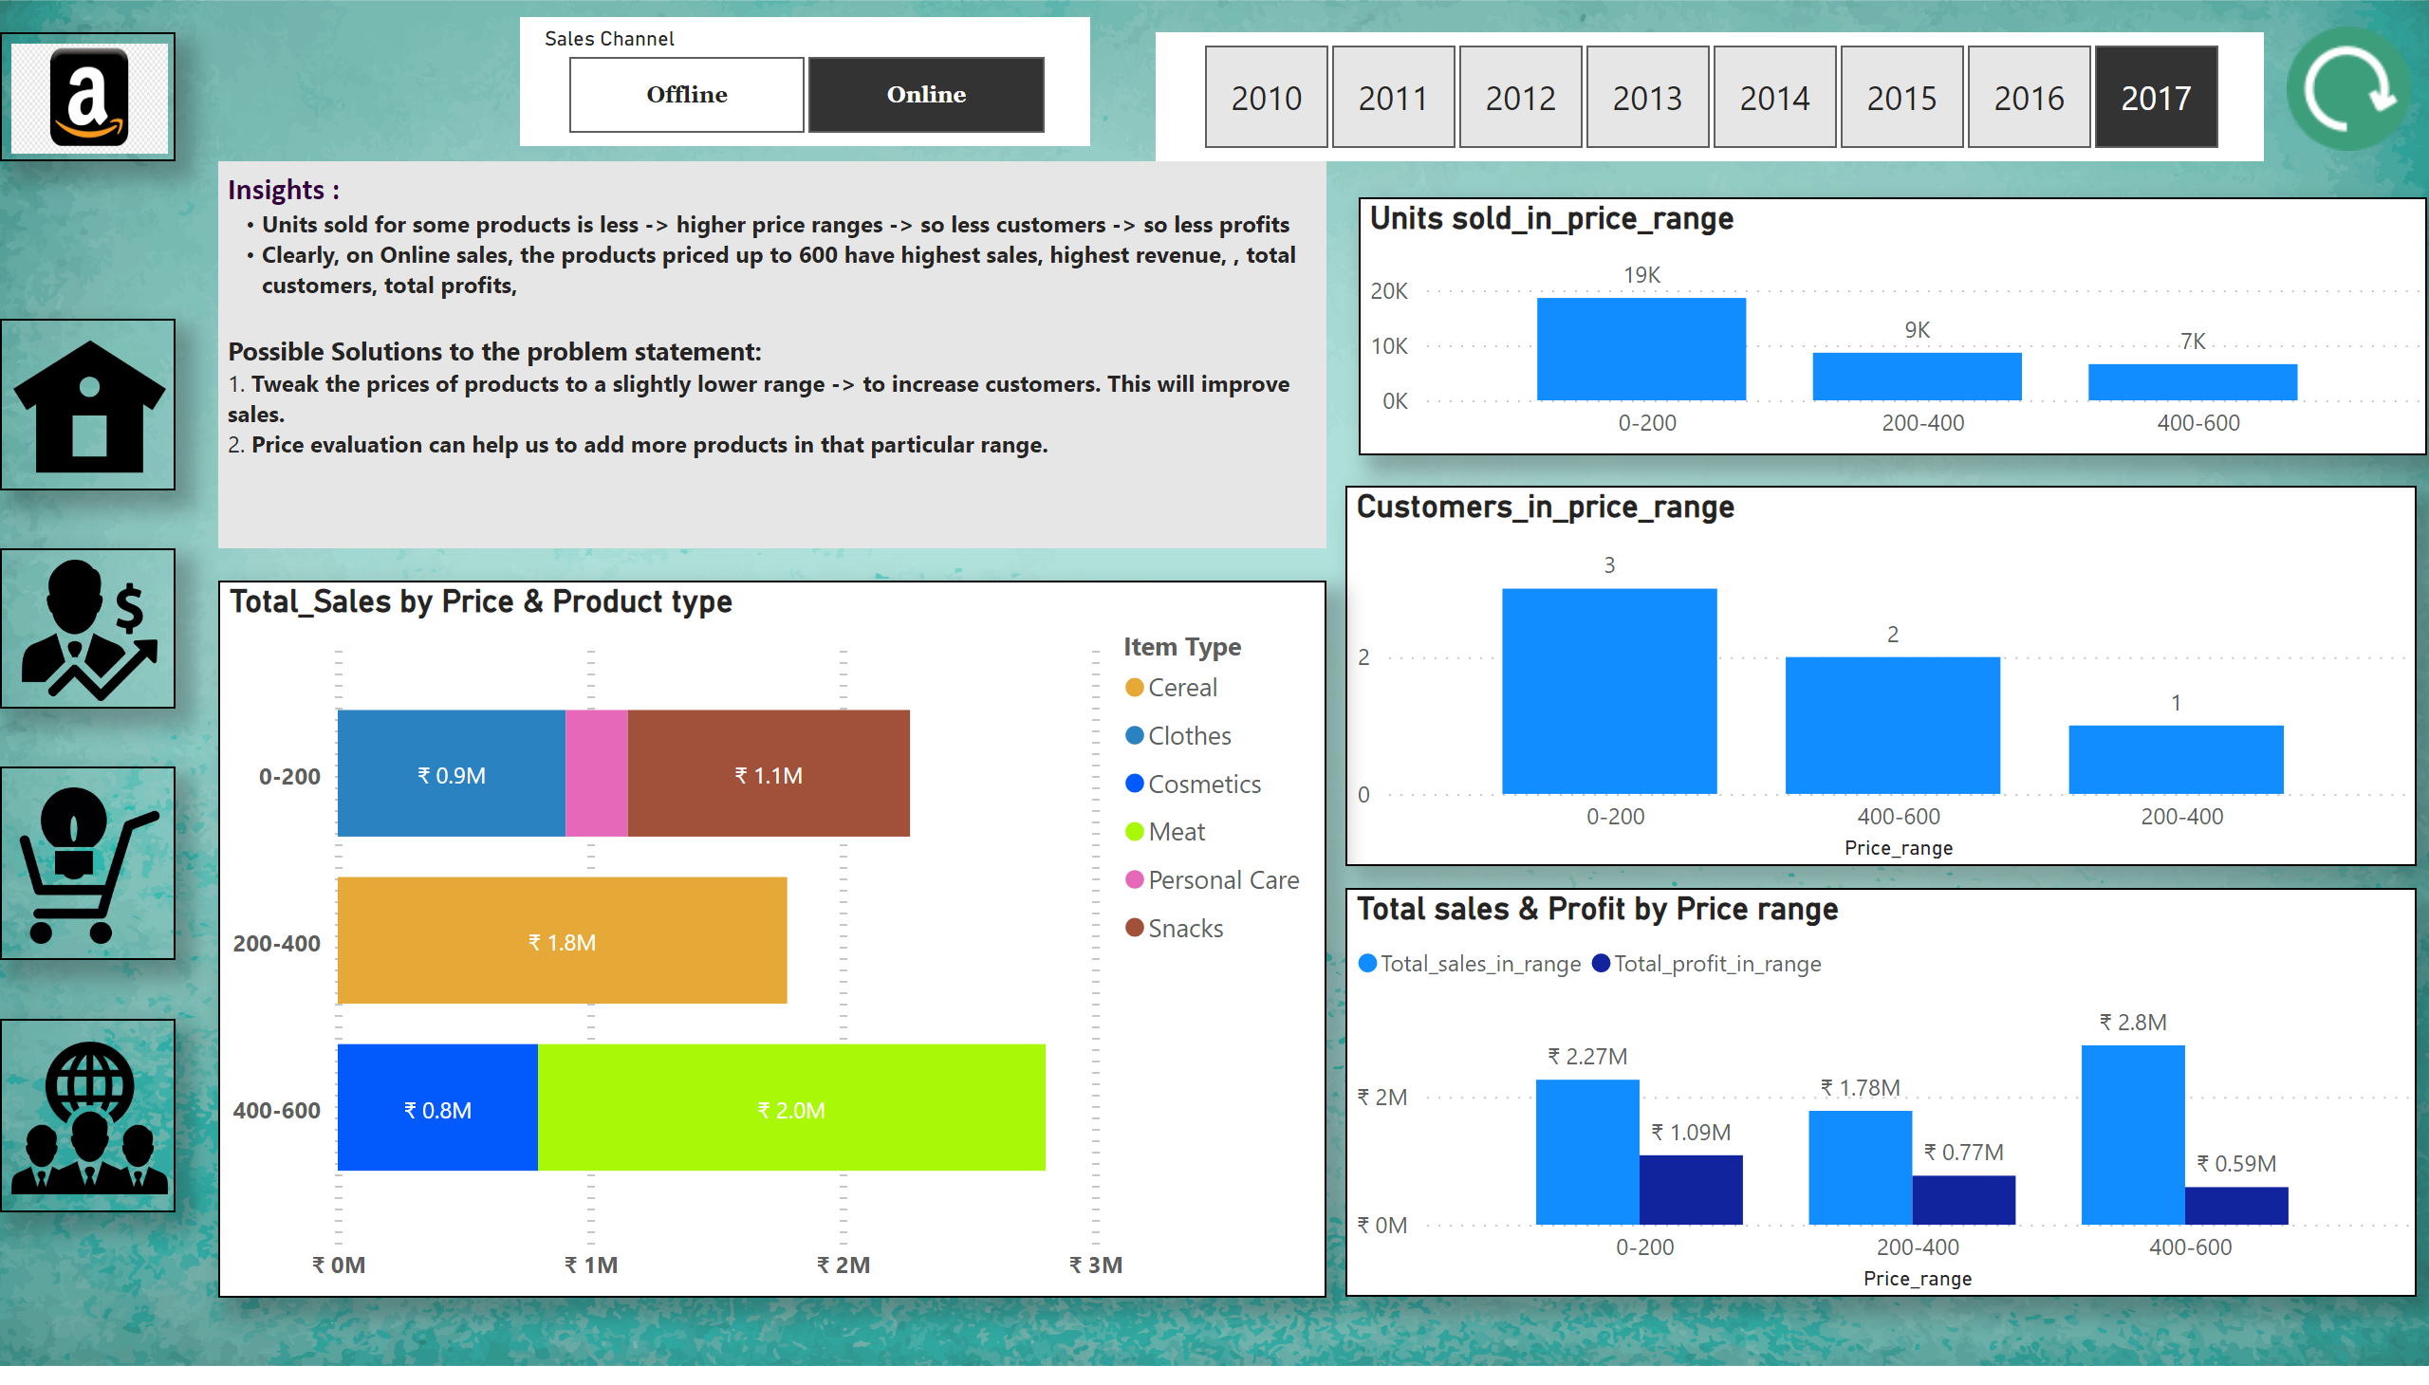
Price analysis
Notes:
Customers_in_price_range
No alt text provided
Total_Sales by Price & Product type
No alt text provided
slicer
No alt text provided
image
No alt text provided
image
No alt text provided
image
No alt text provided
image
No alt text provided
Total sales & Profit by Price range
No alt text provided
image
No alt text provided
image
No alt text provided
textbox
No alt text provided
Units sold_in_price_range
No alt text provided
slicer
No alt text provided

Slide 7
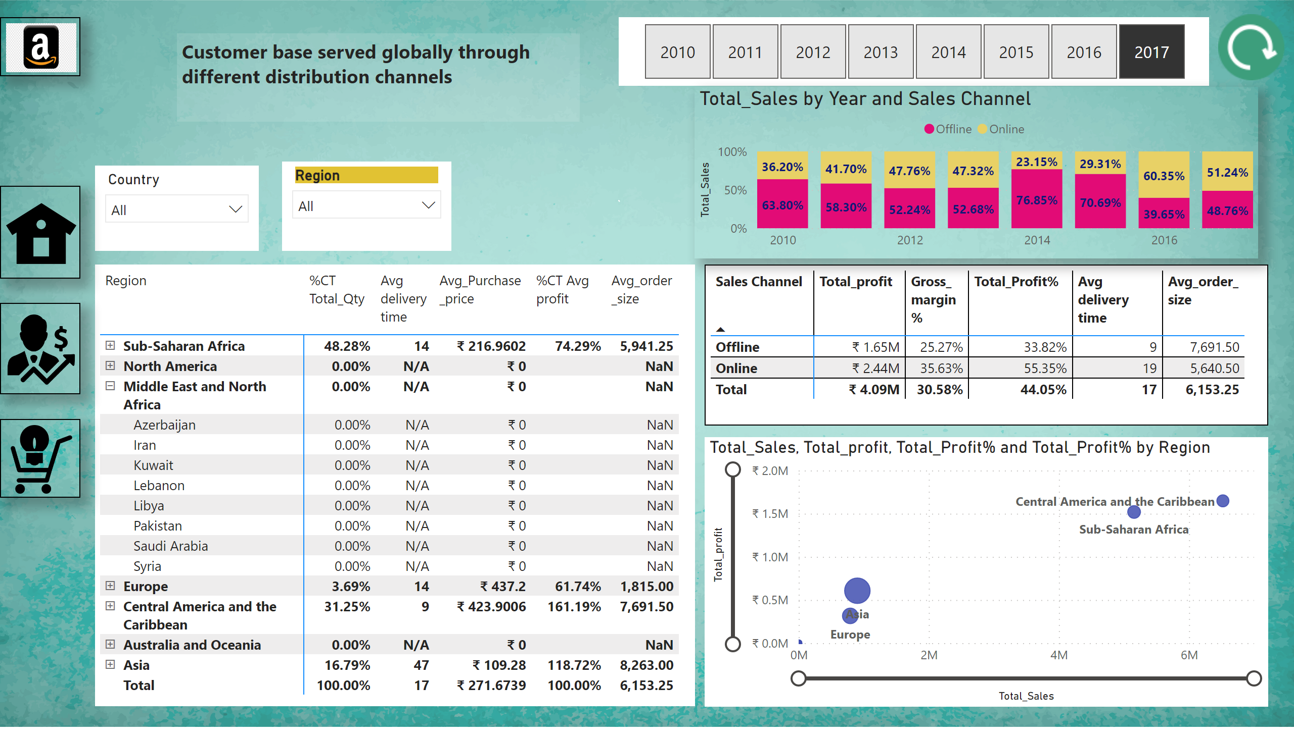
Global outlook
Notes:
pivotTable
No alt text provided
slicer
No alt text provided
hundredPercentStackedColumnChart
No alt text provided
scatterChart
No alt text provided
slicer
No alt text provided
slicer
No alt text provided
pivotTable
No alt text provided
image
No alt text provided
image
No alt text provided
image
No alt text provided
image
No alt text provided
image
No alt text provided
textbox
No alt text provided

